Slide 1

Text Based Game Python Programming
CSUMB CST205
PRESENTED BY:
DANIEL HOWE, ROGELIO MORENO,
JIWANJOT SANDHU, NIKOLA PETKOV

Slide 2
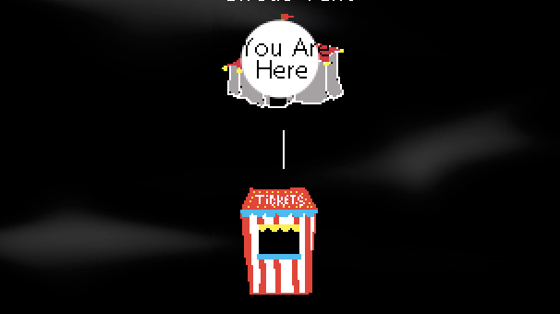
Objective

Slide 3

Objective
USER INTERACTION/ENGAGEMENT
KEYBOARD
SOUND
IMAGES
PROCESS STRINGS
NAVIGATION
HISTORY
COMMANDS

Slide 4
Approach

Slide 5
Approach
Request user to enter their name
Allow user to choose direction of play
Store history
Preserve game logic unique to area

Slide 6
Results

Slide 7
results
Found limitations with filenames:
Windows filename :
“C:\\Users\Elmo\Dorothy”
Mac OS/Linux Filename:
/home/elmo/dorothy
Repaint/draw images

Slide 8
Demo

